Slide 1
Code Converters
Binary-Gray conversions

Slide 2
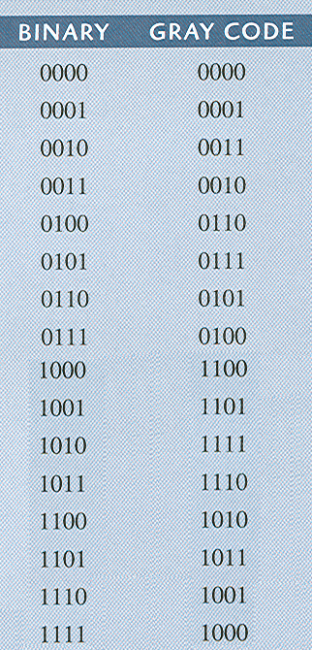
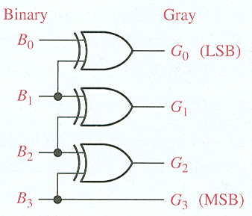
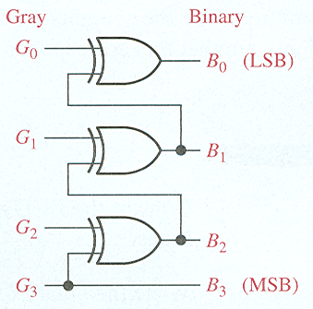
Code Converters
Binary-Gray conversions

Slide 3
Multiplexers (Data Selectors)

Slide 4
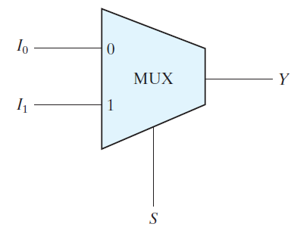
Multiplexer
A multiplexer is a combinational circuit that selects information from one of many input lines and directs it to a single line.
Chapter 4 <number>

Slide 5
MULTIPLEXERS (Data Selectors)
A multiplexers (MUX) is a device that allows digital information from several sources to be routed onto a single line for transmission over that line to a common destination.
The basic multiplexers has several data input lines and a single output line. It also has data- select inputs, which permit digital data on any one of the inputs to be switched to the output line.

Slide 6
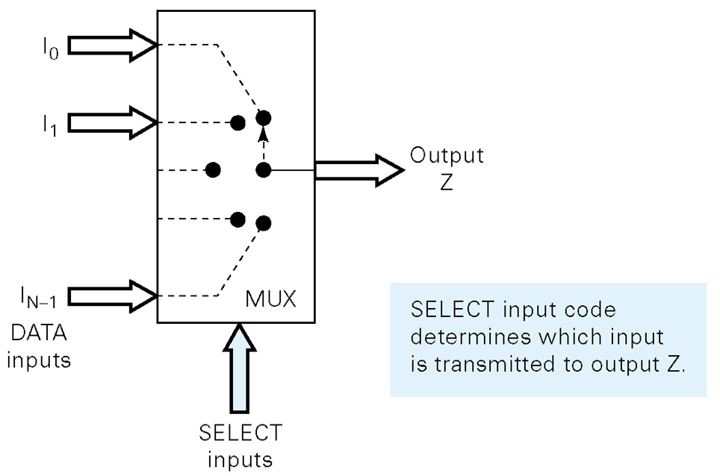
Functional diagram of MUX

Slide 7
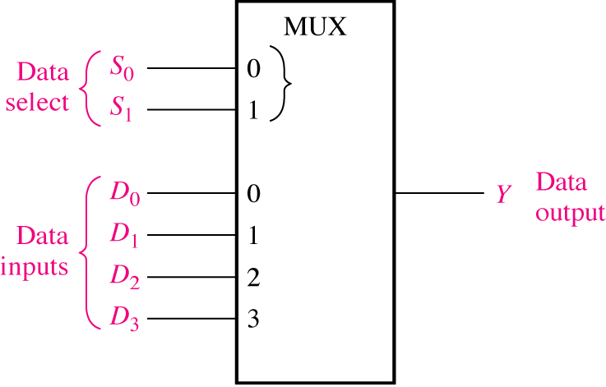
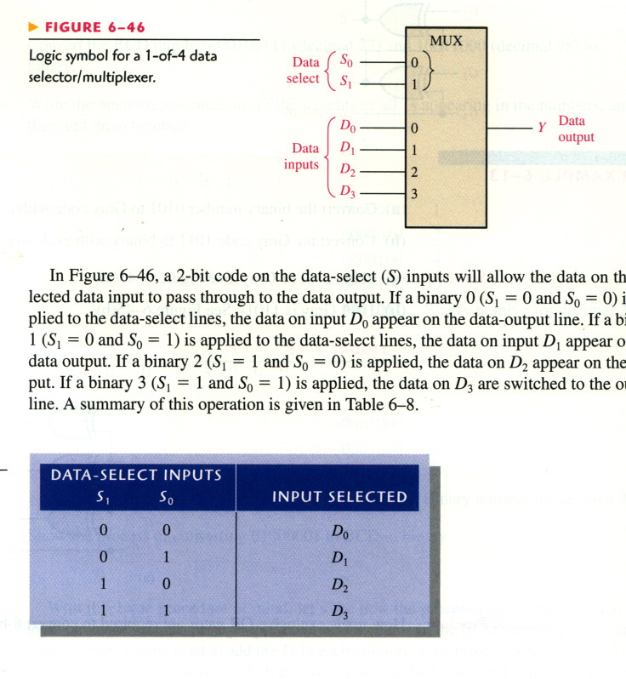
Multiplexers (Data Selectors)

Slide 8
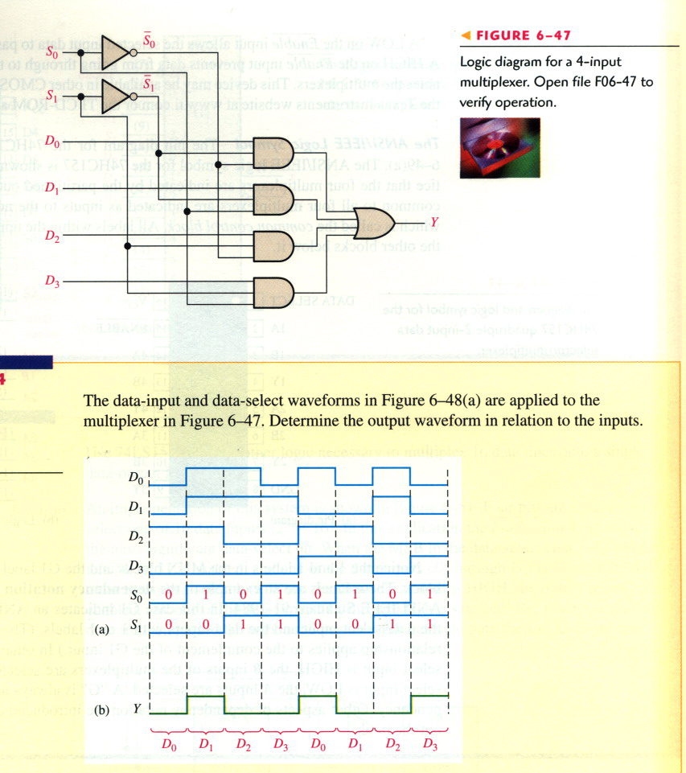
Multiplexers (Data Selectors)

Slide 9
Multiplexers (Data Selectors)

Slide 10
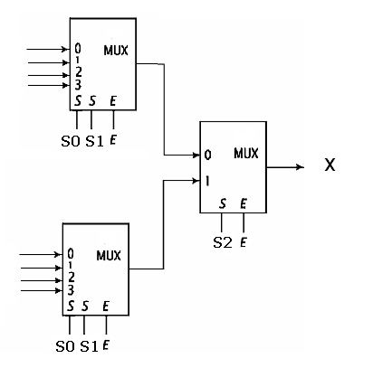
Construct 8-to-1 multiplexer using one 2-to-1 multiplexer and two 4-to-1 multiplexers
S₂ | S₁ | S₀ | X
0 | 0 | 0 | I₀
0 | 0 | 1 | I₁
0 | 1 | 0 | I₂
0 | 1 | 1 | I₃
1 | 0 | 0 | I₄
1 | 0 | 1 | I₅
1 | 1 | 0 | I₆
1 | 1 | 1 | I₇

